Slide 1
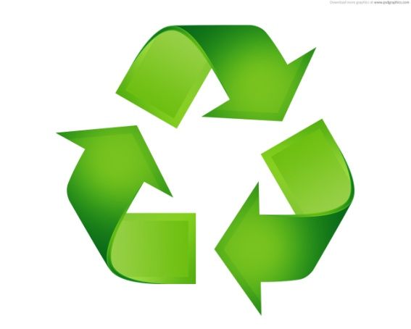
Design and manufacturing of paper recycling machine
Project Members Project Guide
Meet Rajesh Bhati Prof. V.K. Patil
Neeraj Kumar Attri
Sumit Anil Malbari

Slide 2
Purpose
To take step forward in saving Earth
To promote recycling industries
To create awareness for awareness for importance of recycling

Slide 3
Introduction
Paper is one such commodity used by everyone and everyday.
Paper is mainly manufacture by vegetable fibres obtained from trees.
Paper production accounts for about 35% of felled trees.
To ensure forest is not depleted of these woods, alternate source of raw material is required, this lead to paper recycling.
Recycling is the recovery of valuable material from scrap.
Waste paper recycling offers a sustainable solution to environment.
Recycling one ton of paper can roughly save 17 trees.

Slide 4
Recycling not only saves environment but also helps conserve energy
The Energy Information Administration claims a 40% reduction in energy when paper is recycled versus unrecycled paper.

Slide 5
Types of paper used for recycling
3 types of paper are used for recycling
a) Mill broke
b) Pre consumer waste
c) Post consumer waste
Mill Broke: Paper scrap during manufacturing of paper.
Pre consumer waste: left the paper mill but discarded before consumer use.
Post consumer waste: paper discarded after consumer waste.

Slide 6
Paper recycling process
White paper recycling consist of 5 major processes
Pulping
Refining
Deinking
Forming
Wet Pressing and Drying

Slide 7
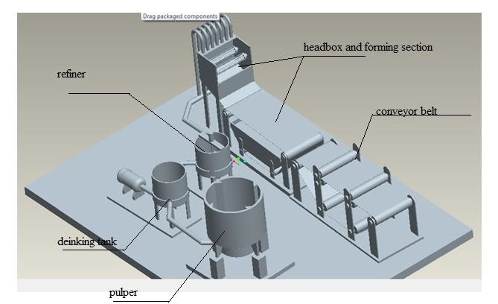
Virtual setup of Paper recycling Machine

Slide 8
Pulping
Pulping is the process to create crushed virgin pulp
It disintegrate the fibre by action of mechanical operation.
Pulping is done in a large cylindrical tank called pulper
The most significant part of pulper is its blade
Blade can arranged in two ways- sideways and at bottom.
These arrangement helps create required turbulence
Blade disintegrates the paper into tiny strands of cellulose called fibre.

Slide 9
Design
1) Pulper
Volume Capacity = 40 litres
Height of pulper = 60 cm
Diameter of pulper = 29 cm
2) Blade
Diameter of blade = 19.2 to 24.8 cm
Thickness of blade = 2 mm
3) Shaft connected to the blade
Diameter of Shaft = 12 mm

Slide 10
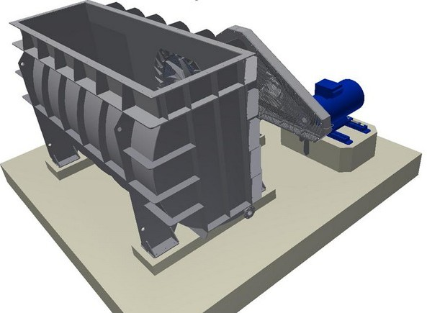
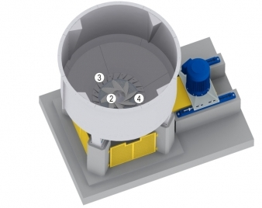
Sideways blade position pulper
Bottom blade position pulper

Slide 11
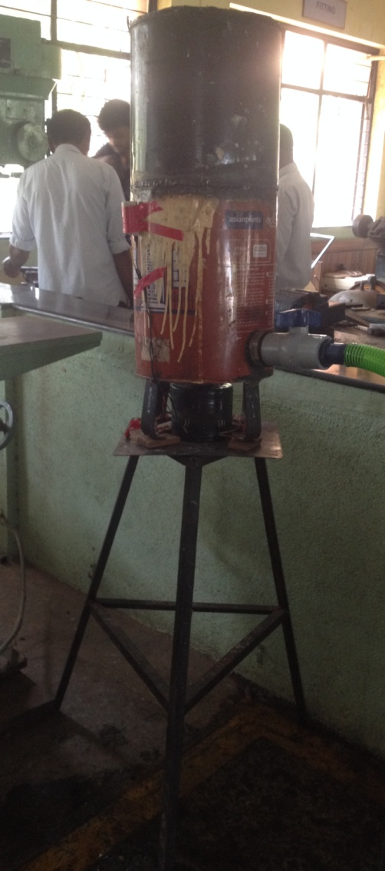
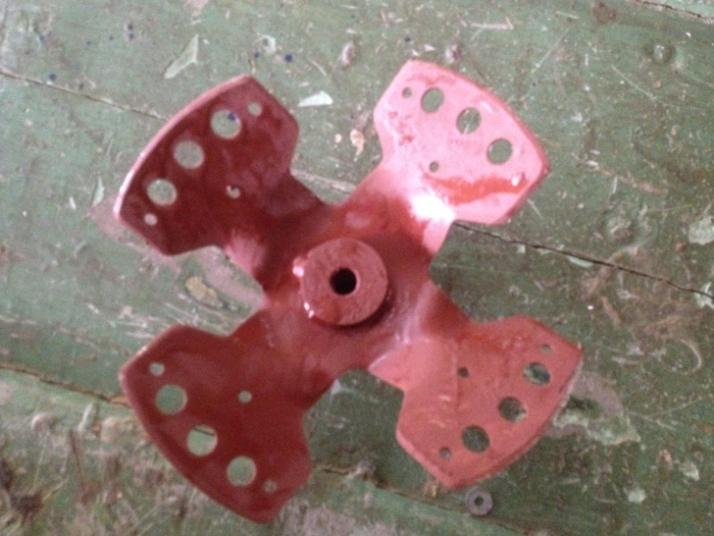
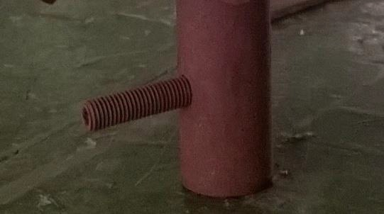
Components of pulping
Blade
Shaft connected to blade
Actual setup for pulping process

Slide 12
Refining
Refining is the operation in which through mechanical work in presence of aqueous medium, the morphology of fibres and their physical- chemical structure changes.
Refining is carried out in equipment called refiner.
Refiner consist of two major components-stationer tank and other rotational(rotor), between which the pulp is made to pass.
Rotor is equipped with blade for treating fibre.
COMPOSITON OF FIBRE
1) Carbohydrate(Cellulose and Hemicellulose)
2) Lignin
3)other compound(Resins, Tannins)

Slide 13
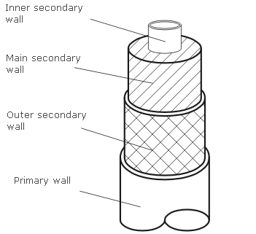
Fibre structure

Slide 14
Effect of refining
Effects of refining can be grouped in 3
Hydration
Fibrillation
Trimming

Slide 15
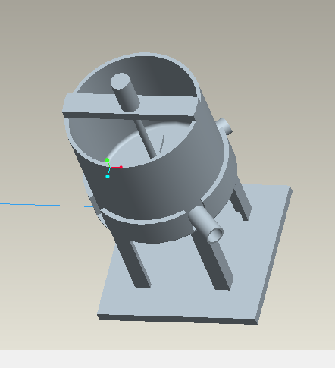
Design
1) Refining Tank
Volume capacity = 20 litres
Height of tank = 30 cm
Diameter of tank = 29 cm
Virtual setup of
Refining

Slide 16
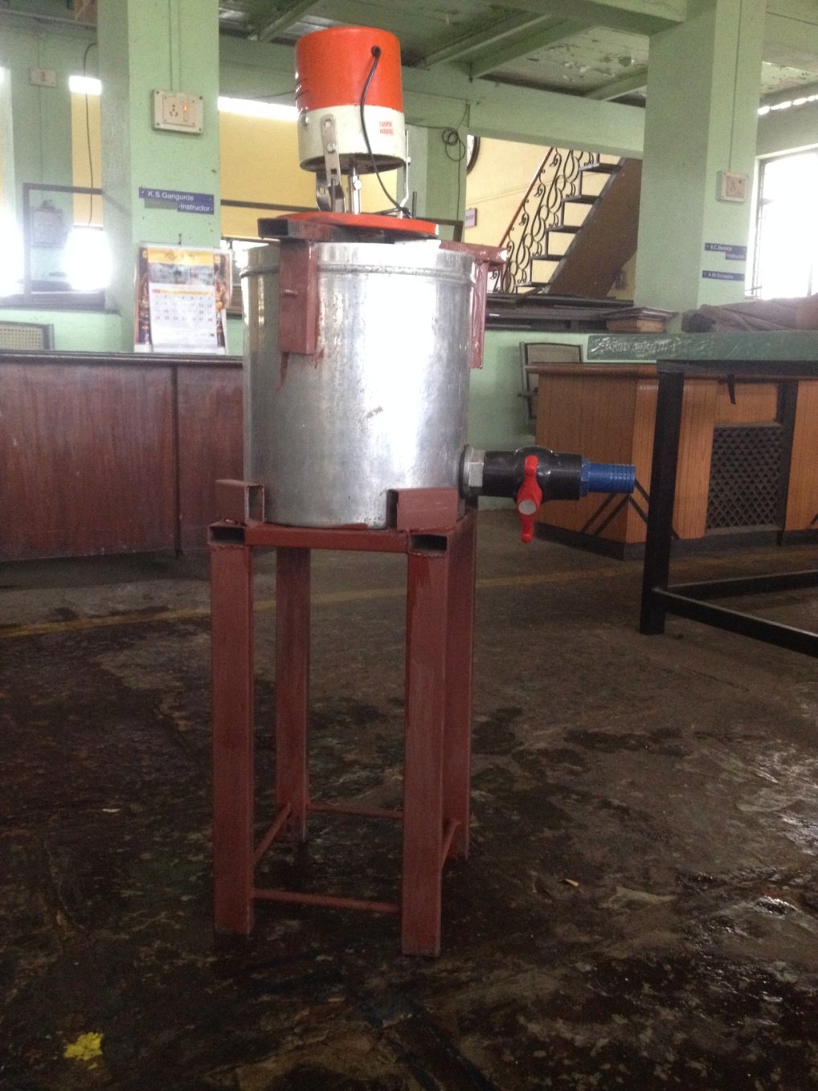
Actual Setup for Refining process

Slide 17
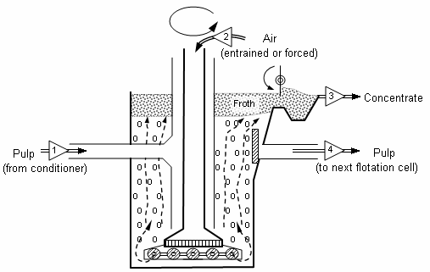
Deinking
Deinking is the process of removing printing ink from paper
Ink from paper is detached by chemical and mechanical process
FLOTATION DEINKING

Slide 18
Chemicals used During deinking
Sodium Hydroxide- causes increase in pH which aids in ink removal.
Sodium Silicate- acts as dispersant to prevent ink from depositing on fiber surface.
The ink is hydrophobic in nature
When ionic surfactants is absorbed into ink particle the hydrophilic part gets oriented with water
The hydrophobic part of surfactant align with hydrophobic air bubble and thus the ink gets removed removed with the bubbles.

Slide 19
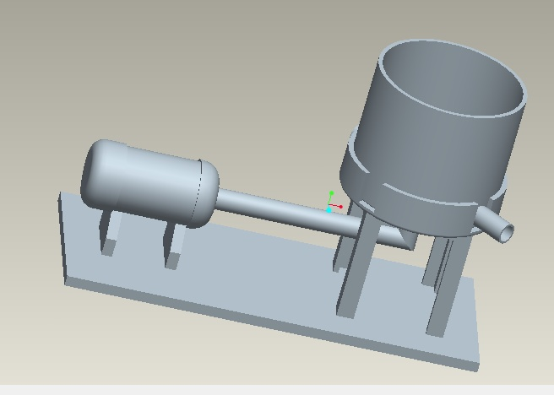
Design
Volume capacity = 20litres
Length = 40 cm
Breadth = 30 cm
Height = 18 cm
Virtual setup for
Deinking process

Slide 20
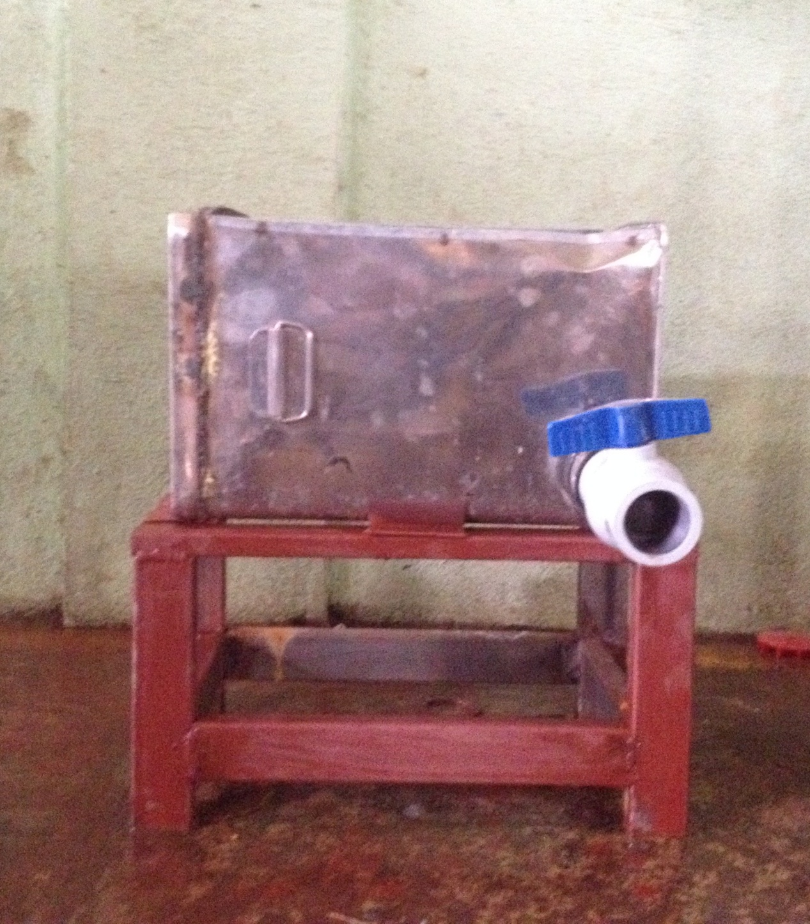
Actual Setup for deinking process

Slide 21
Forming
This process involves the transformation of diluted pulp into fine, wide uniform sheet of paper.
It consist of 2 major components
1)Headbox - responsible for output of pulp onto forming table in the form of thin ,wide and uniform sheet.
The headbox performs 3 major tasks
a) Spread the stock evenly along the width of the paper machine
b) Accelerate the stock up to the machine operating speed.
c) Suspend the pulp fibers throughout the outgoing slurry.

Slide 22
2) Forming Table - responsible for producing the sheet and reducing part of the water contained by the pulp.
The pulp sent via lip of headbox is deposited on continous wire responsible for transporting fibres along forming table.
As water is removed fibre remains on the wire , this fibre will eventually be the sheet of paper.
Water from pulp can be removed in two steps:
1) Dewatering by gravity
2) vacuum dewatering

Slide 23
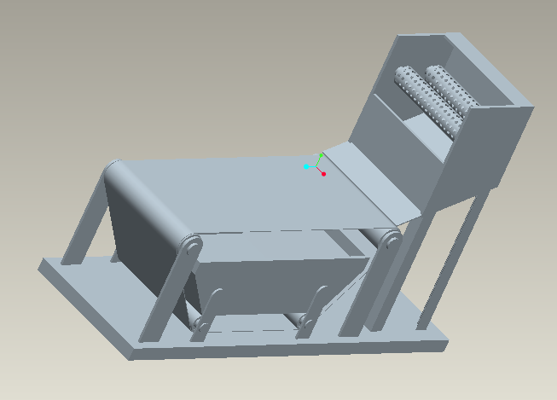
Design
1) Headbox
Volume capacity = 27 litres
Length =breadth = height = 30 cm
2) Shaft in forming table
Diameter = 17 mm
3) Bearing selected
6003
Virtual Setup For
Forming process

Slide 24
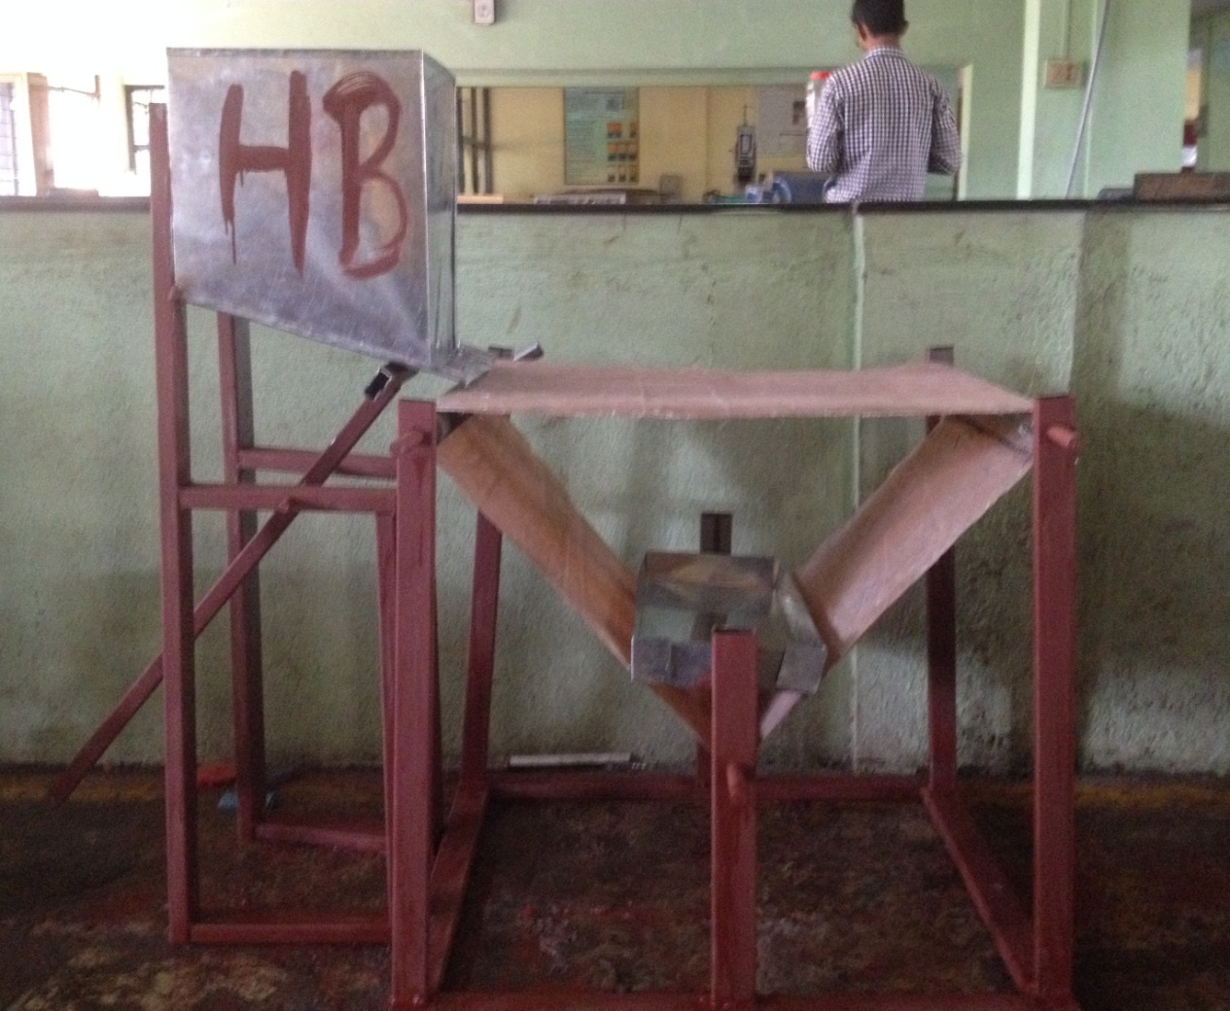
Actual Setup for forming process

Slide 25
Wet pressing and Drying
This is the final step in paper formation
Once certain amount of water is removed it passes through number of rollers to remove the water remaining in the sheet
This process consist of 2 steps
1)Wet pressing – this is known as pressing section
When the paper leaves the forming table it consist of 80% water, at the end of pressing section water content reduces to approx. 60%
In this process the sheet of paper passes through number of rolls that put pressure on the paper and manage to remove 20 % water

Slide 26
Principle function of pressing section
The extraction of maximum amount of water possible, uniformly along the width of the machine.
To maximize the quality of the sheet, giving it surface smoothness, without reducing its thickness in excess, and assuring that both sides are the same.
The 4 pressing stage are
Compression and saturation of the sheet (stage I):
Compression and saturation of the felt (stage II):
Expansion of the felt (stage III):
Expansion of the sheet (stage IV):

Slide 27
2) Drying – responsible for removing the remaining water by heating
When sheet enters this section it contains 60 % water.
The moisture content in the paper is reduced to 5 % after passing through this process.
The wet sheet of paper passes through heated rollers, causing the water in paper to evaporate.
The aim of drying operation is to obtain:
A homogenous formation of sheet
A homogenous drying profile
A regular distribution of temperature to the sheet
Drying can be carried from many process but the most famous is drying by heated cylinder
In this method sheet stays in contact with heated roller on one side and with bottom cylinder on other.

Slide 28
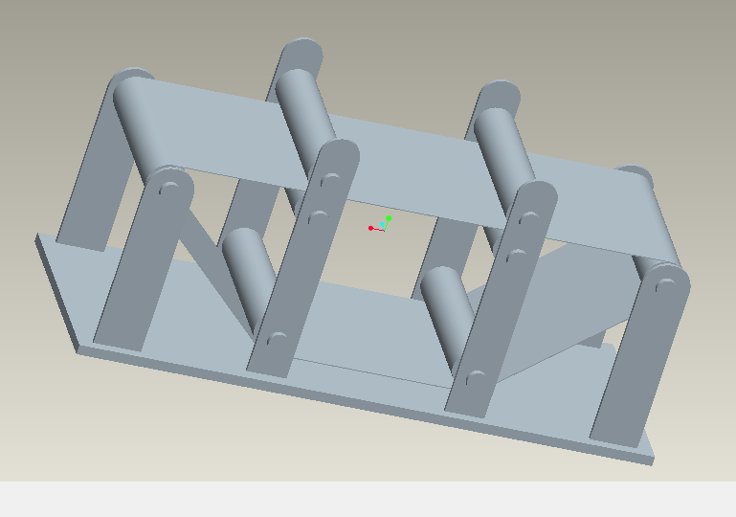
Design
Diameter of shaft = 17 mm
Bearing selected : 6003
Volumetric flow rate of belt = 5.153m^3/kg
Virtual setup of pressing and drying section

Slide 29
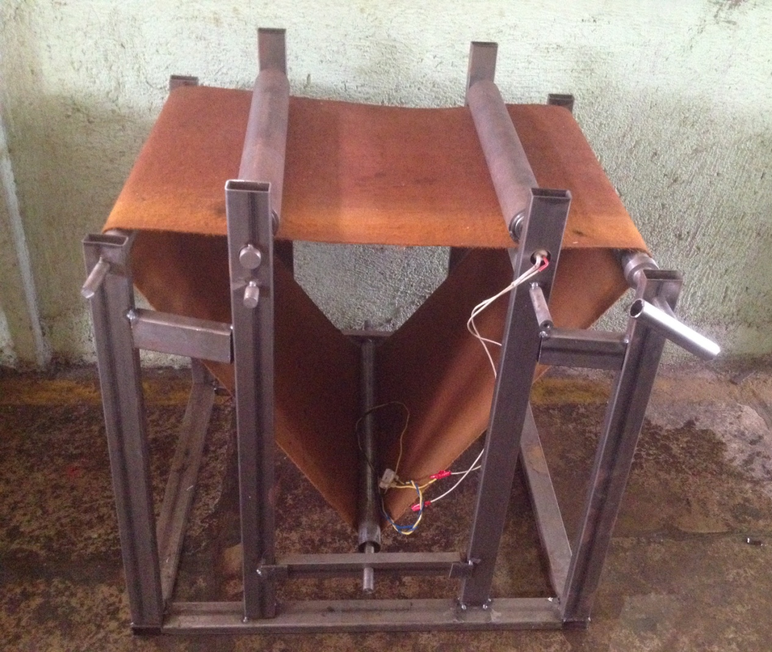
Actual Setup of pressing and drying Section

Slide 30
Future Scope
With further advancement in design and technology, production can enhanced.
It can be made fully automatic.
With proper development of this prototype and adopting advance simulation technique large scale production is possible

Slide 31
Conclusion
Lots of deforestation occurs due to manufacture of new paper
Recycling is the alternative to save the environment
So we have tried a take step in saving environment through our project

Slide 32
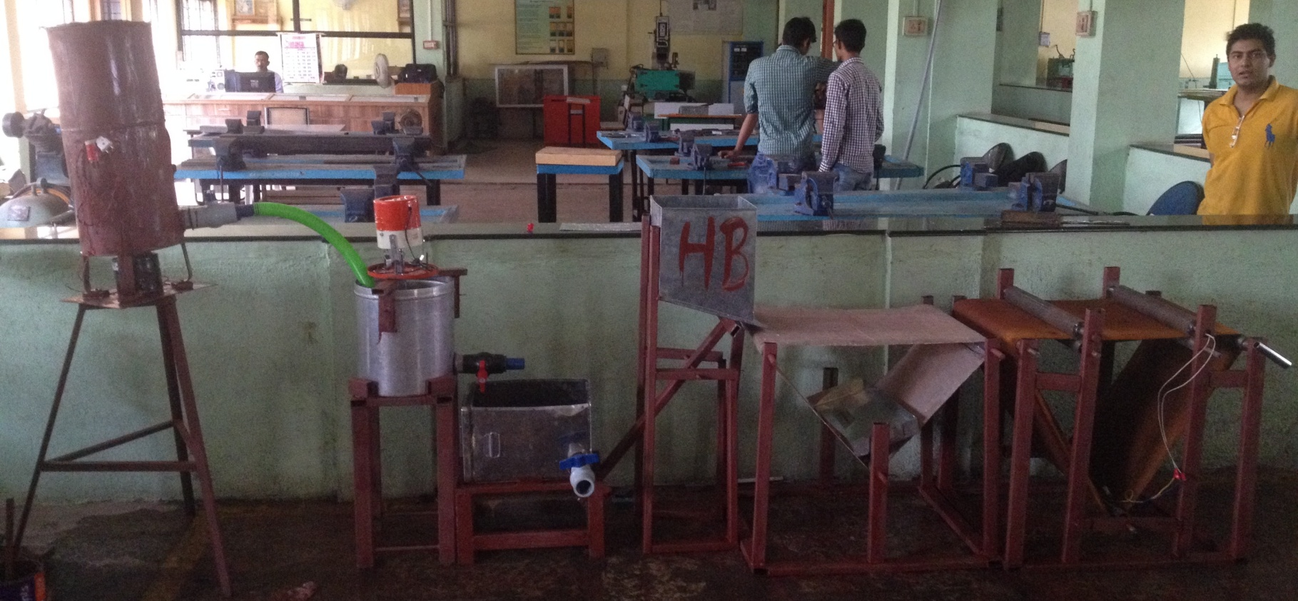
Actual Setup of Paper Recycling Machine

Slide 33
THANK YOU

